Slide 1
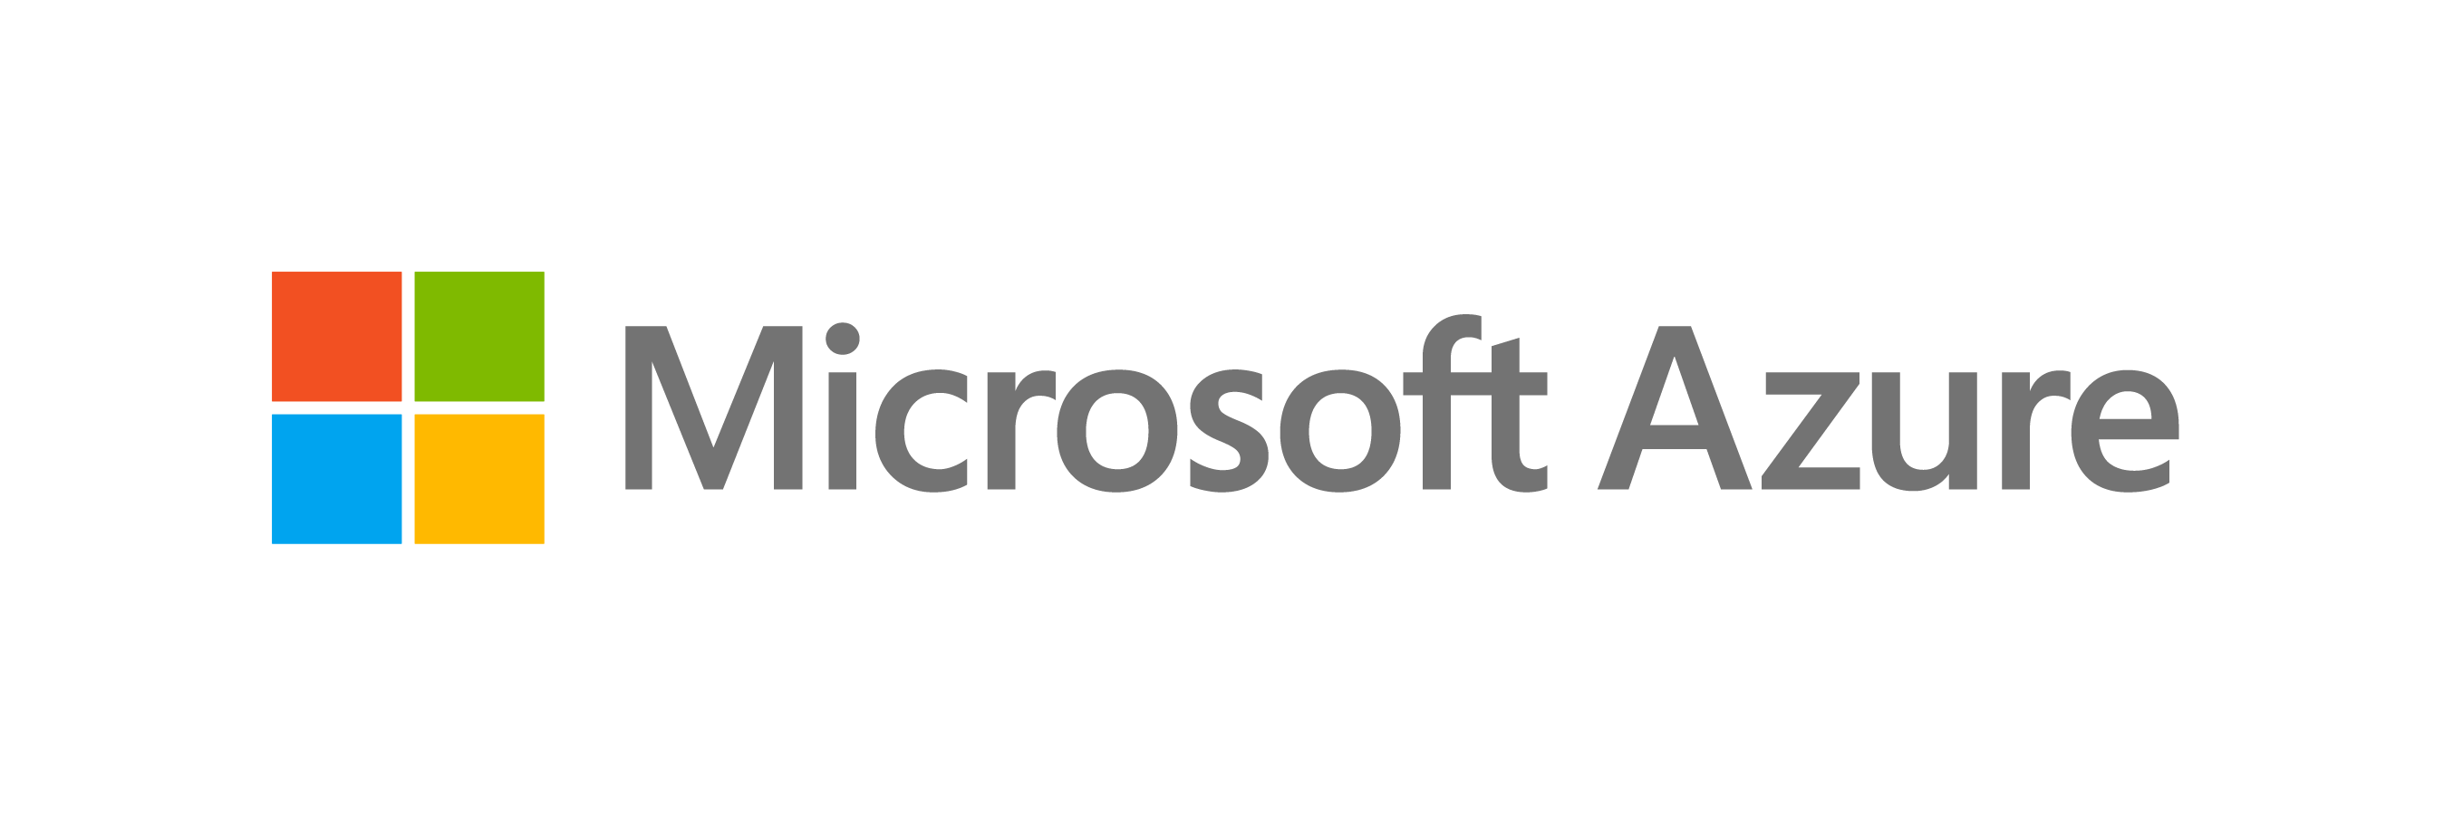

Cloud Transformation
Sarah Lean
Cloud Solution Architect – Datacentre Migration Specialist
@TechieLass

Slide 2
Software and hardware refresh
Security threats
Urgent capacity needs
Compliance
Quickly integrate acquisitions
Application innovation
Migration & modernization triggers
Software end of support
Datacenter contracts expiry
Sarah Lean @Techielass

Slide 3
EOS presents opportunity to modernize your infrastructure & avoid business risk
2008 | R2
No security updates
Compliance &
regulatory concerns
Windows Server
Ends January 14, 2020
$
Additional cost for support + patches
Missed innovation opportunities
SQL Server
Ends July 9, 2019
Sarah Lean @Techielass
Find lifecycle support deadlines at: support.microsoft.com/lifecycle

Slide 4
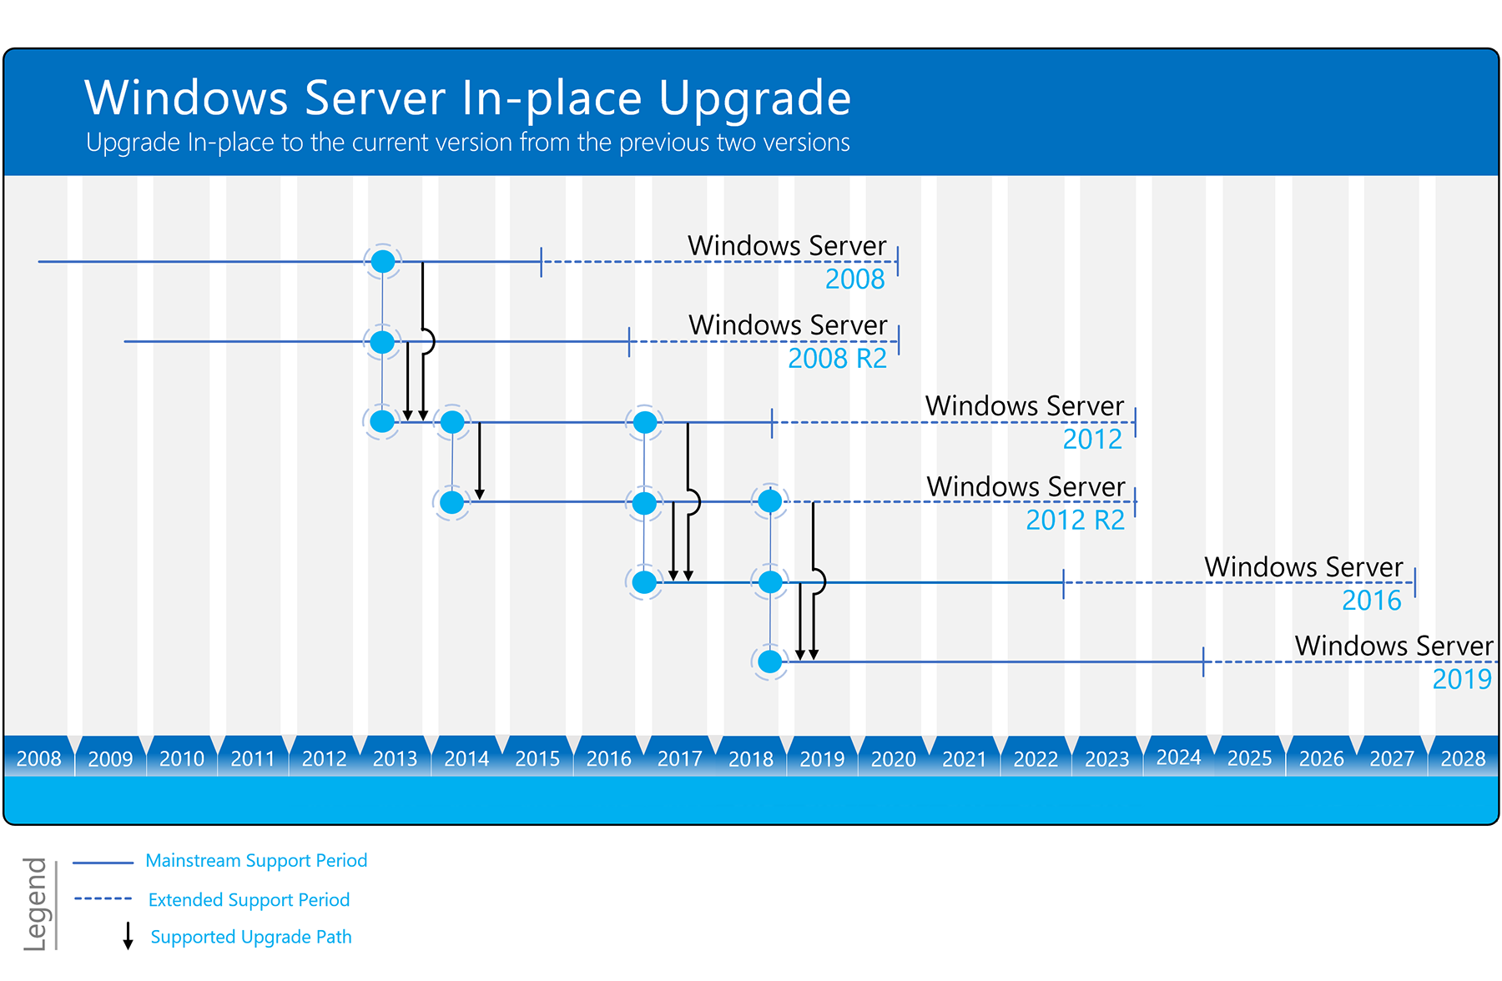
https://www.microsoft.com/upgradecenter

Slide 5
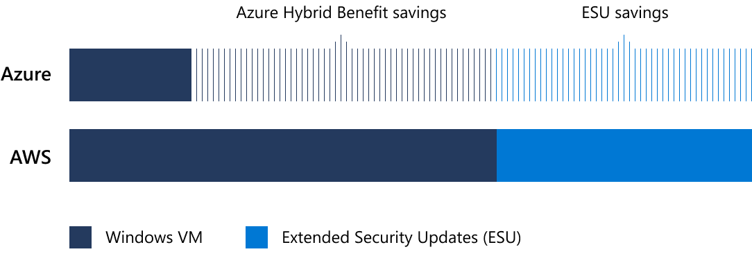
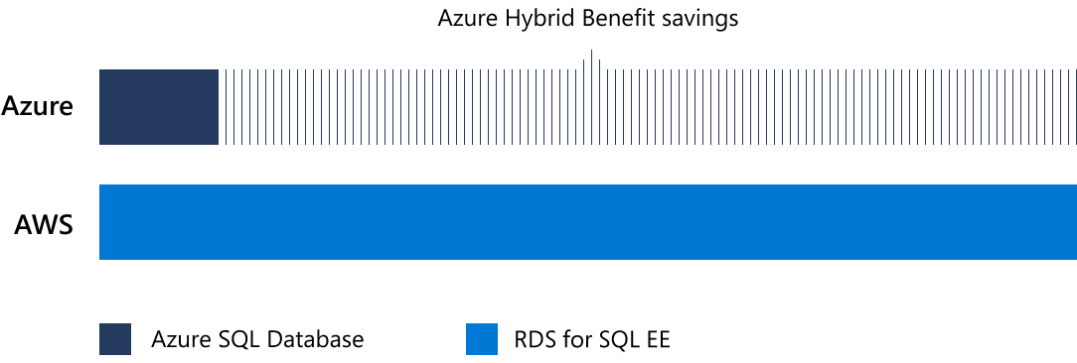


Extended security updates, free only on Azure
Windows Server savings illustration
Pay less with Azure. AWS is 5x
more expensive.
Other cloud service providers may claim to have similar savings to the Azure Hybrid Benefit, but you’ll need to repurchase your Windows Server license on those clouds. And only Azure offers free extended security updates for Windows Server 2008 and 2008 R2.
3 years of security updates after support ends
75% of the license cost to buy standalone
Reuse existing licenses with Azure Hybrid Benefit
SQL Server savings illustration (PaaS)
Only Azure offers savings across both platform-as-a-service (PaaS) and infrastructure-as-a-service (IaaS) for SQL Server. With the Azure Hybrid Benefit, you can use existing licenses with Software Assurance to pay a reduced rate on Azure SQL Database (PaaS). This is not included in SQL Server license mobility rights for other clouds.
Sarah Lean @Techielass
Learn more: aka.ms/why5xmore

Slide 6

Azure is the best destination for Windows Server and SQL Server
Unique hybrid experiences: Server + Azure
Unparalleled consistency & innovation: Azure SQL Database Managed Instance
Deep trust with
enterprises
Azure Security Center + built-in OS security
Windows Admin Center
Integrated backup, disaster recovery, & identity
Full parity with 100% code consistency
Unmatched support & backward compatibility
Machine learning-based performance & security
More certifications than other providers
Single vendor support
Reuse familiar skills and toolsets
Sarah Lean @Techielass

Slide 7
Migration/ Modernization strategies, projects, and innovation
Sarah Lean @Techielass

Slide 8
Azure migration & modernization scenarios
App
Migration & Modernization
Cloud-native
SaaS
On-premises
Data
Rehost
Refactor
Rearchitect
Rebuild/New
Replace
Infrastructure
Virtual Machines
Containers
App, Data, & AI Services
Security | Management
Sarah Lean @Techielass
Notes:
These are the Azure migration scenarios and associated technologies. These scenarios are based off of an industry standard framework.
Rehost: Redeploy as-is to cloud; used for quick ROI, freeing up DC space, least effort. IaaS is the key tech here.
Refactor: Minimally alter to take better advantage of cloud; used for code portability and quick updates. Containers and PaaS are the key tech here.
Rearchitect: Materially alter/decompose application to services; to enhance app scale and agility. PaaS, Serverless and Microservices are key tech here.
Rebuild: New code written with cloud native approach; to accelerate innovation and build apps faster. PaaS, Serverless and Microservices are key tech here.

Slide 9


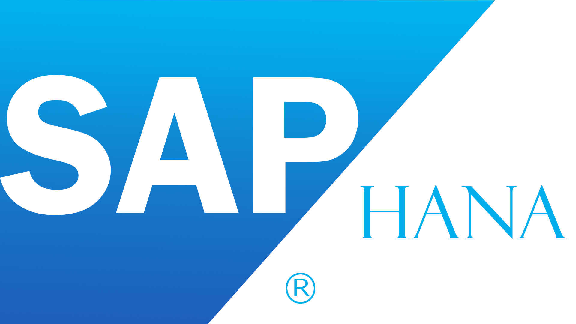
Common Azure migration/modernization projects
Windows Server
File servers, containers, AD/DNS/DHCP
SQL Server
Application databases, Analytics (BI, DW)
ASP.NET/ PHP/ Java apps
Customer facing & internal LoB
Linux/ Open source databases
(e.g., RedHat/SUSE, Hadoop, MySQL,
PostgreSQL, NoSQL)
SAP
Specialized workloads
e.g., HPC, NetApp
Sarah Lean @Techielass

Slide 10








Reliable infrastructure to rehost any workload
On-demand
Purpose-built
Linux, Open Source, and Red Hat
Best for Microsoft workloads
+40%
Unique hybrid experiences: Server + Azure
Compute
of Azure VMs are running Linux
1.4x
Unparalleled consistency & innovation: Azure SQL DB Managed Instance
Networking
growth of Linux
Co-located support with Red Hat on-site team
Deep trust with enterprises
Storage
Sarah Lean @Techielass

Slide 11
Azure migration journey and tools
Sarah Lean @Techielass

Slide 12
Unified and extensible Azure migration experience
Assess
Migrate
Optimize
Secure and manage
Migration tools | Azure migration center | Scenario guidance | FastTrack for Azure | Azure Expert MSPs
Azure Fundamentals
Target architecture | Governance | Connectivity | Security | Training & Readiness
Sarah Lean @Techielass

Slide 13





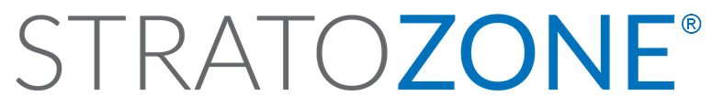


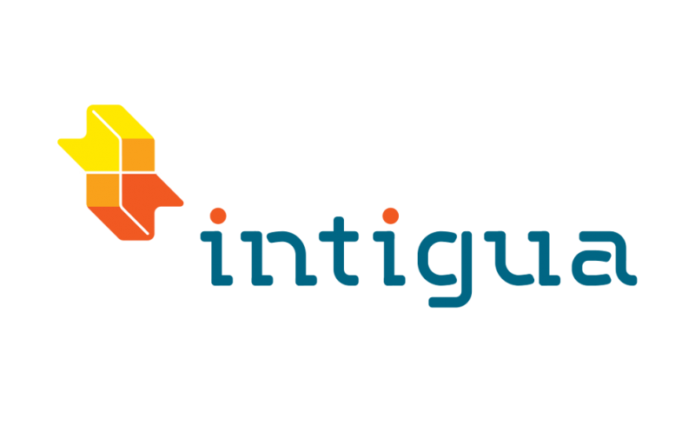







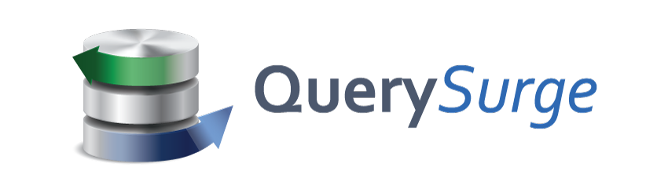
Choice of tools for every stage and every requirement
Goal is successful Azure migration: Pick the right tool for the job
Assess
Migrate
Optimize
Secure & Manage
Azure Migrate
Azure Site Recovery (ASR)
Azure Cost Management
Azure Advisor
Azure Security & Management
(e.g., Blueprints, Security Center, Backup, Monitor)
Data Migration Assistant (DMA)
Azure Database Migration Service
SQL Server Migration Assistant (SSMA)
Azure Data Box
We embrace ISV solutions
Sarah Lean @Techielass

Slide 14





Azure Fundamentals: Governance
Governance becomes very critical as you scale Azure migration efforts
NEW
NEW
NEW
Management Group
Policy
Blueprints
Resource Graph
Cost Management
Define organizational hierarchy
Real-time enforcement, compliance assessment and remediation
Deploy and update cloud environments in a repeatable manner using composable artifacts
Query, explore & analyze cloud resources at scale
Monitor cloud spend and optimize resources
Hierarchy
Control
Environment
Visibility
Consumption
Sarah Lean @Techielass

Slide 15
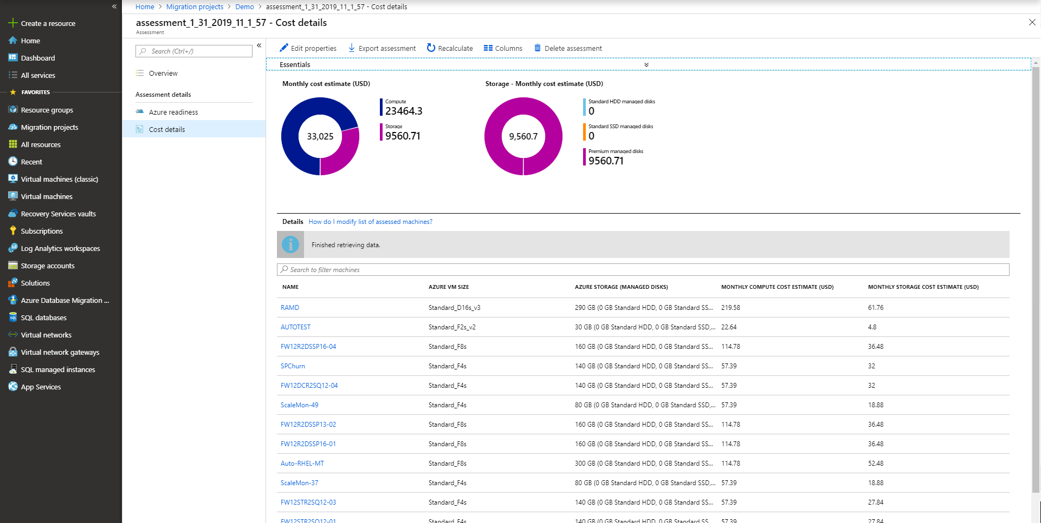
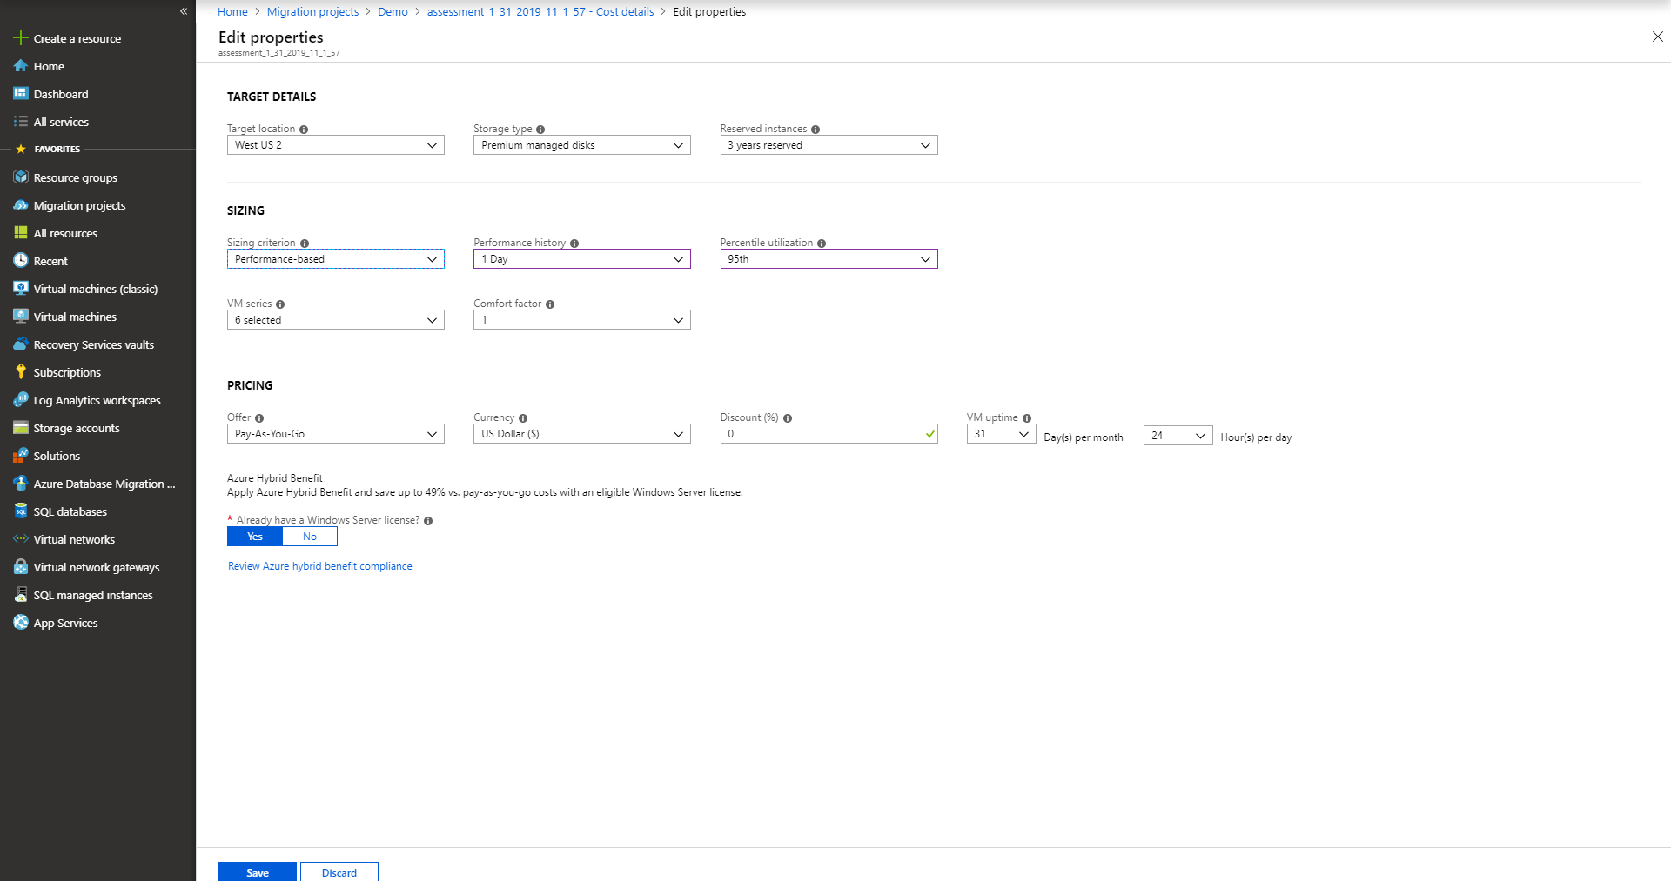

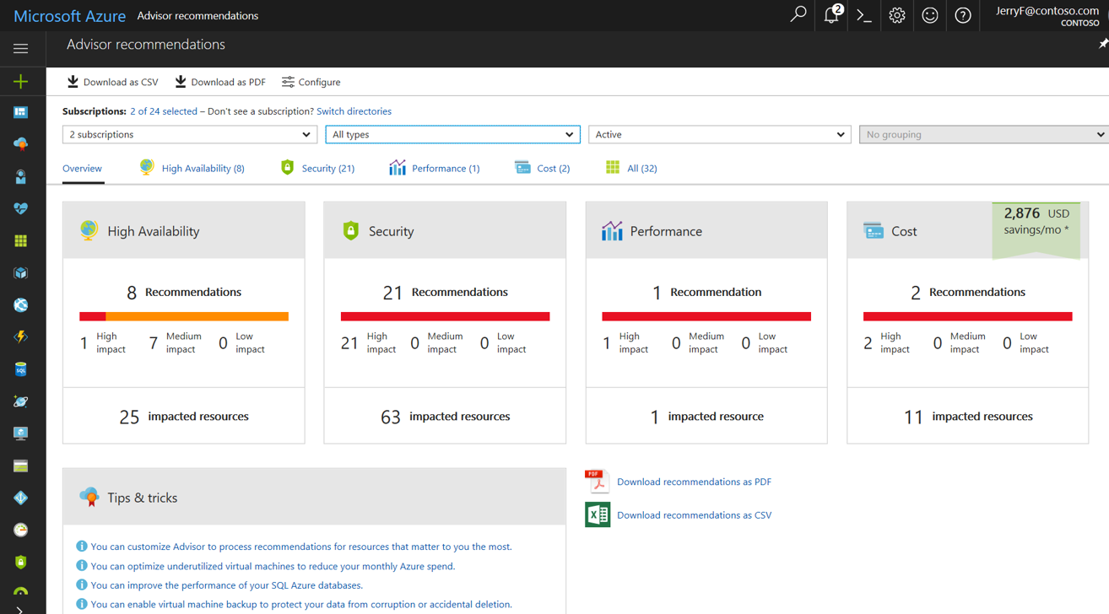
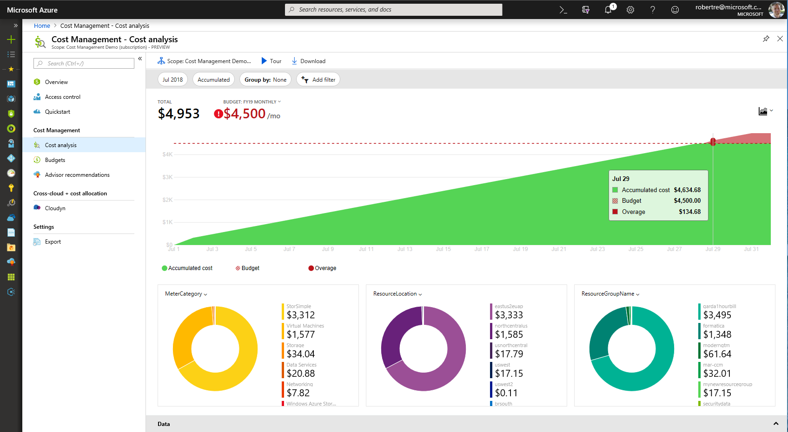
Continuously optimize resources during and after migration
As you move
Right-size Azure resources based on assessment guidance
Use Azure Hybrid Benefit and Azure Reserved Instances to save money
After you move
Unified experience to optimize cloud spends: Azure Cost Management
Azure Advisor: Built-in best practice recommendations
(e.g., turn off idle VMs)
Modernize for longer term value
Sarah Lean @Techielass

Slide 16
Key resources and investments
Sarah Lean @Techielass

Slide 17
Key elements to successful migrations
Migration approach
Migration Tools
Offers
Migration partners
Training
Sarah Lean @Techielass

Slide 18
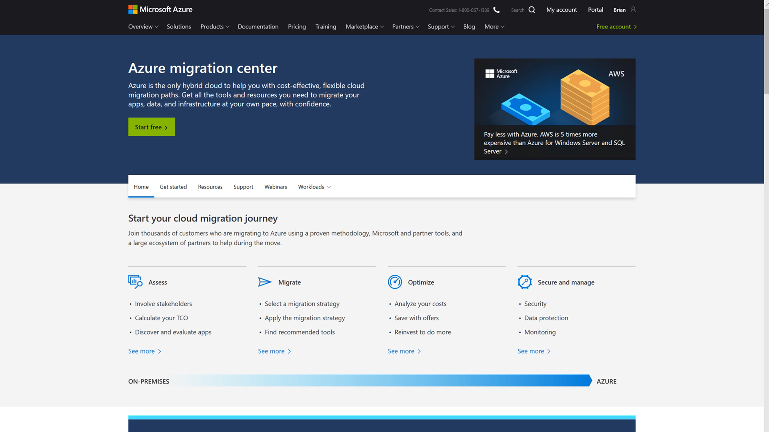
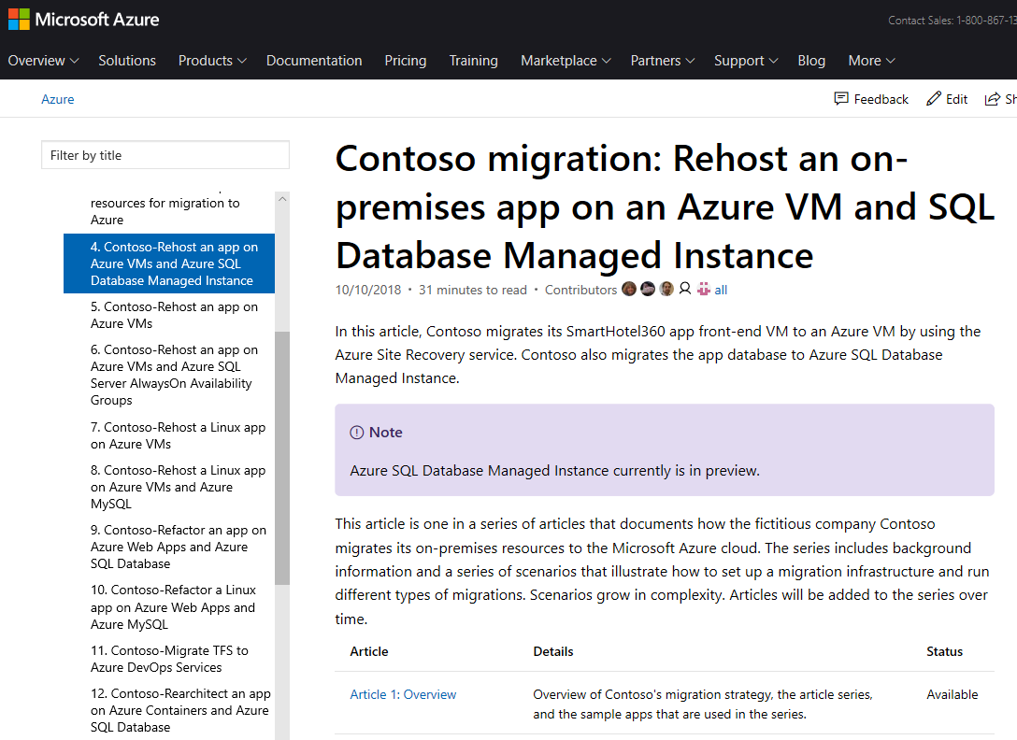
Migration approach
All things migration
(guidance, tools, support)
Detailed walkthrough of different migration scenarios
Azure.com/Migration
aka.ms/contoso-migration
Sarah Lean @Techielass

Slide 19
Microsoft Cloud Adoption Framework for Azure
Best practices
Templates
People
Process
Technology
Documentation
Tools
Achieve balance
Align business, people and technology strategy to achieve business goals with actionable, efficient, and comprehensive guidance to deliver fast results with control and stability.
https://aka.ms/caf
Sarah Lean @Techielass

Slide 20
Azure Migration Program (AMP)
Available to all Azure customers, scaled through specialized migration partners
Best practice guidance
Offers and incentives
Technical skill building
Infrastructure and data foundations
Migration planning and execution
FastTrack for Azure engineers
Digital resources
Migration
Tools
Azure trainers
FastTrack for Azure engineers
Specialized partners
Reduce cost and risk | Accelerate migration velocity | Deliver customer success
Learn more | Azure.com/AMP
Sarah Lean @Techielass

Slide 21
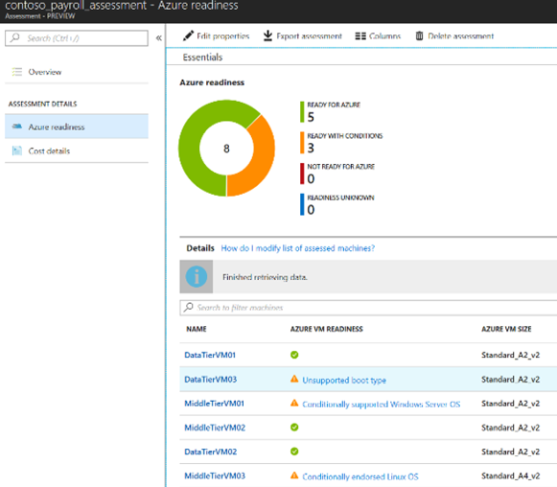
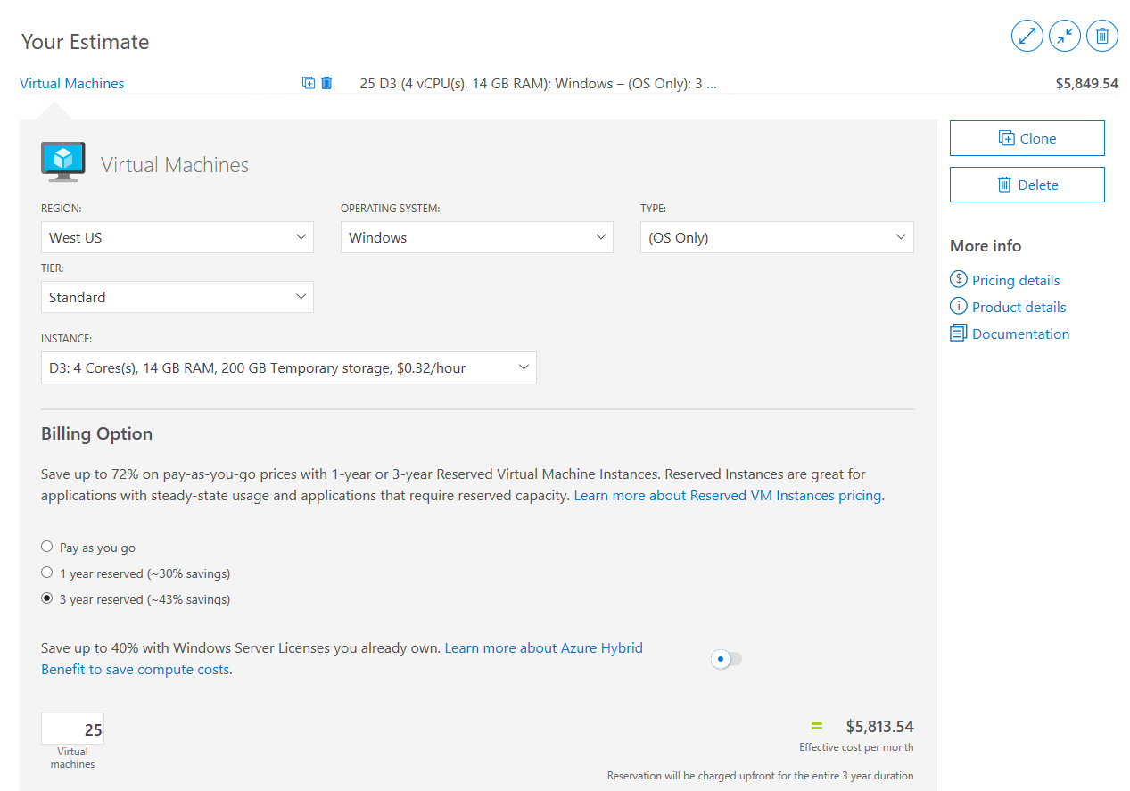
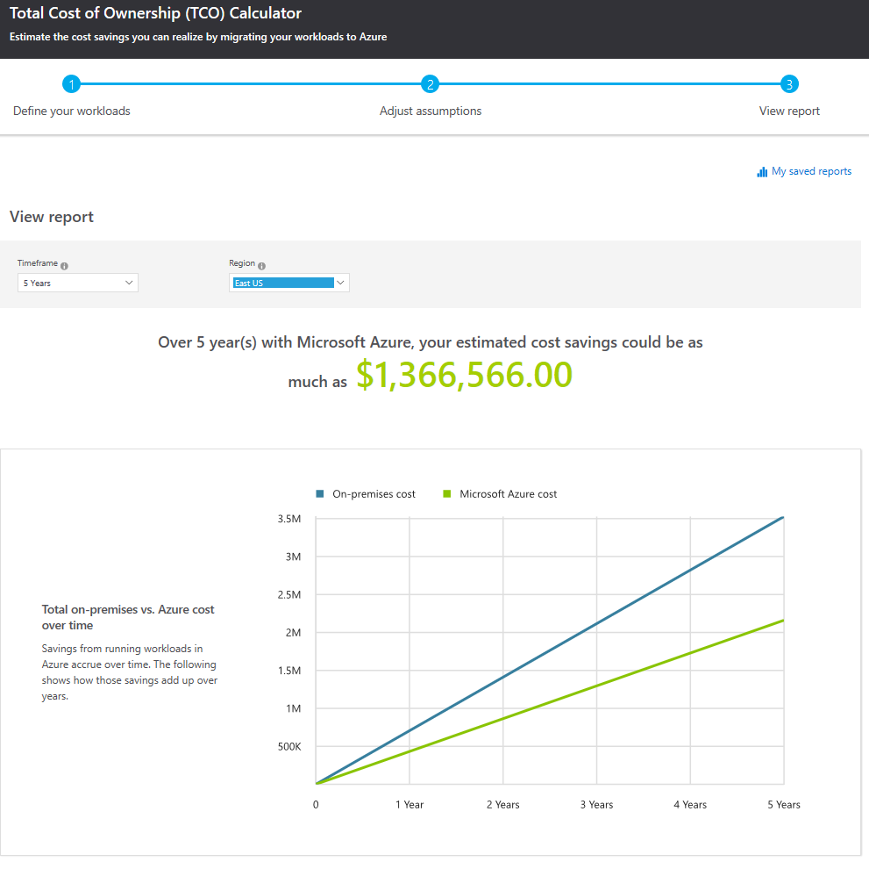
Best practice example: Building a cloud business case
Gather Inventory
Azure Migrate or Partner Tools
Azure Pricing Calculator
Configure and estimate costs for Azure products
azure.com/pricing/calculator
Azure TCO Calculator
Estimate on-premises costs vs. Azure
azure.com/tco
Sarah Lean @Techielass

Slide 22



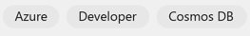
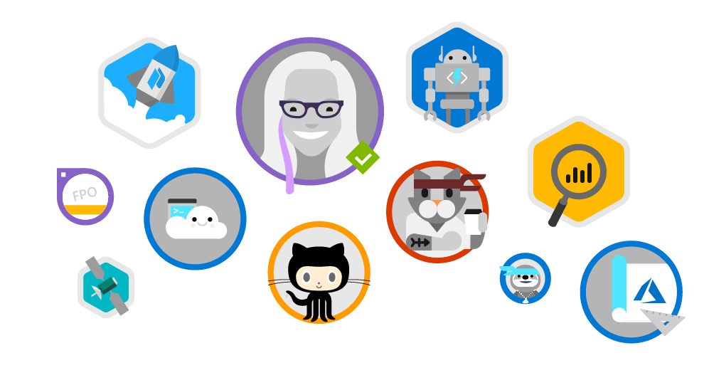
Microsoft Learn
www.microsoft.com/learn
Step-by-Step Learning
Gamification & Achievements
Friction-Free Learning
Guided microlearning by product/service, difficulty, job role, etc
Videos, tutorials, and hands-on learning
Role-based learning paths to prepare for certification
Unlock achievements
Task-based achievements to reward your hands-on skills
Customizable user profile
All learning content is free
Content available in the spoken language and programming language of my choice
No-install, browser-based Interactive coding/scripting environments
All scripts and code samples available for download
Sarah Lean @Techielass

Slide 23

https://aka.ms/sarahfeedback

Slide 24
https://aka.ms/sarahfeedback
Thank you | Q&A
@TechieLass

